Slide 1


Accenture Innovation Challenge
Harness Generative AI to develop innovative solutions that boost business and societal growth

Slide 2



Team details
TEAM NAME: Treasure Hunt Techies
Saai Krahaanth (Team Leader)
Prasanth
College: Prince Dr K Vasudevan College of Engineering & Technology
Stream: Computer Science Engineering
Year of graduation: 2025
College: Prince Dr K Vasudevan College of Engineering & Technology
Stream: Computer Science Engineering
Year of graduation: 2025
Mohith Shakthi
Photo
College: Prince Dr K Vasudevan College of Engineering & Technology
Stream: Computer Science Engineering
Year of graduation: 2025

Slide 3
Describe the problem statement (200 words)
Limited Users for Smartphone Access: Due to diverse reasons, certain individuals may not own a smartphone either because they do not possess one, the phone is out of battery, or it’s lost which restricts their means of carrying on an interaction during an emergency.
Kidnapping Scenarios: After securing the victim, the assailants will remove even her smartphone as most victims are likely to use this to call out for aid. There are periods during any crisis situations when communication has to be accomplished in the fastest ways possible which is this specific concern.
Elderly Individuals: The elderly when faced with health crises might require the attention of others and in the absence of such assistance, they will try to summon help but because of lack of access to smartphones or their poor operation during vital moments, assistance is often unattainable.
Children Going to School: In quite a good number of instances, students are subjected into a no-smartphone rule which prohibits them the possession on a single efficient mode of communication which is the too displeasing for most parents and the teaching subjects.

Slide 4
Proposed solution / your big Idea (200 words)
The smart SOS keychain solution to emergencies, to combine with new technologies to make the device robust but portable, uses a set of key technologies:
GPS Tracking: Mini GPS module for automatic send of real-time location to the emergency contact upon pressing the SOS button.
Communication (GSM): The device would work independently on GSM for the most secure and reliable alert and data of the location to reach the contact without relying on smartphones even at low signal.
Voice Transmission: Integrated microphone helps in live audio transmission which allows the respondent to hear the situation and assess the environment of the user.
Low-Power Microcontroller: Controls all of the device functions to optimize use of the batteries and to extend run time per charge.
Rechargeable Long-life Battery: Powers the device for days or weeks; charging is via USB or wireless.

Slide 5
How does your innovation accelerate change with the power of Technology? (200 words)
This advancement quickens the pace of improvements by utilizing compact and easily available technology to ensure safety and communication in the event of danger when there is no smartphone. The identification incorporates the advanced GPS, low-power communication technologies and voice calling into one energy-efficient device that can fit in one’s palm. Hence, instead of making all these technologies in a smartphone, which a majority of the people including children and elderly may not have during emergencies, these are made in a keychain.
Combined with GPS for easy navigation, location smart devices have the additional advantage of using long-range GSM, wireless long-range LoRa tech, which allows users to send alerts or messages without having physical access to phones. This undermines the conventional practices of emergency response that heavily depend on the modern-day smartphones by making it possible to provide assistance even during abductions or serious medical emergencies .This keychain device offers a straightforward and intuitive answer while eradicating the dependence on personal devices and perfectly suitable for use including controlling the targeted population in the most vulnerable situations making the people more responsible for their protection.
On the other hand, This depends on the development of the Internet of Things, shrinking electronics and efficient communication networks and so more smart faster actions are taken during critical times. In so doing, it enhances a global, connected approach where the risk of danger is reduced and technology acts as a savior when one is in peril, making it for social good.

Slide 6
How is your solution different/unique from other solutions in market? (150 words)
The other distinguishing points include smartphone independence, compactness, and multifunctionality, making it stand out from other existing solutions. While most emergency devices depend on apps connected to smartphones, this particular device is able to function solely on its own, and this will make it priceless in conditions where a phone is unavailable-because of kidnapping, for elderly emergencies, or for schoolchildren who do not have phones.
Basic panic buttons or trackers cannot be compared with this keychain which has GPS location tracking and voice transmission together with long-range communication that will make it the most comprehensive emergency response system. Its compact design allows it to be quite transportable and its solidity makes it even possible to withstand very harsh conditions, hence reliable in most scenarios.
Not only are there the opportunities for simplicity in using a single SOS button, but the device's ease of use ensures that an elderly person or a young child with minimal technological know-how can easily activate it. In any case, this unique combination of features means it is both effective and practical as a safety solution.
PATENT FILED: No
Do you have a working model/prototype: Yes
If not, will you be able to show working prototype during finale. Yes

Slide 7
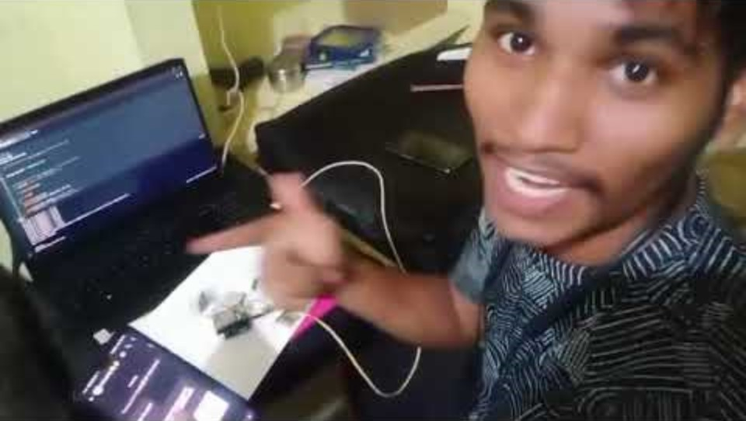
Please share a 1-minute video of your idea (embed on this PPT or add a downloadable link)
https://youtu.be/X_SdaodN2OM?si=uEjvmVkEGJ4JniW8

Slide 8
Thank you!

